Slide 1
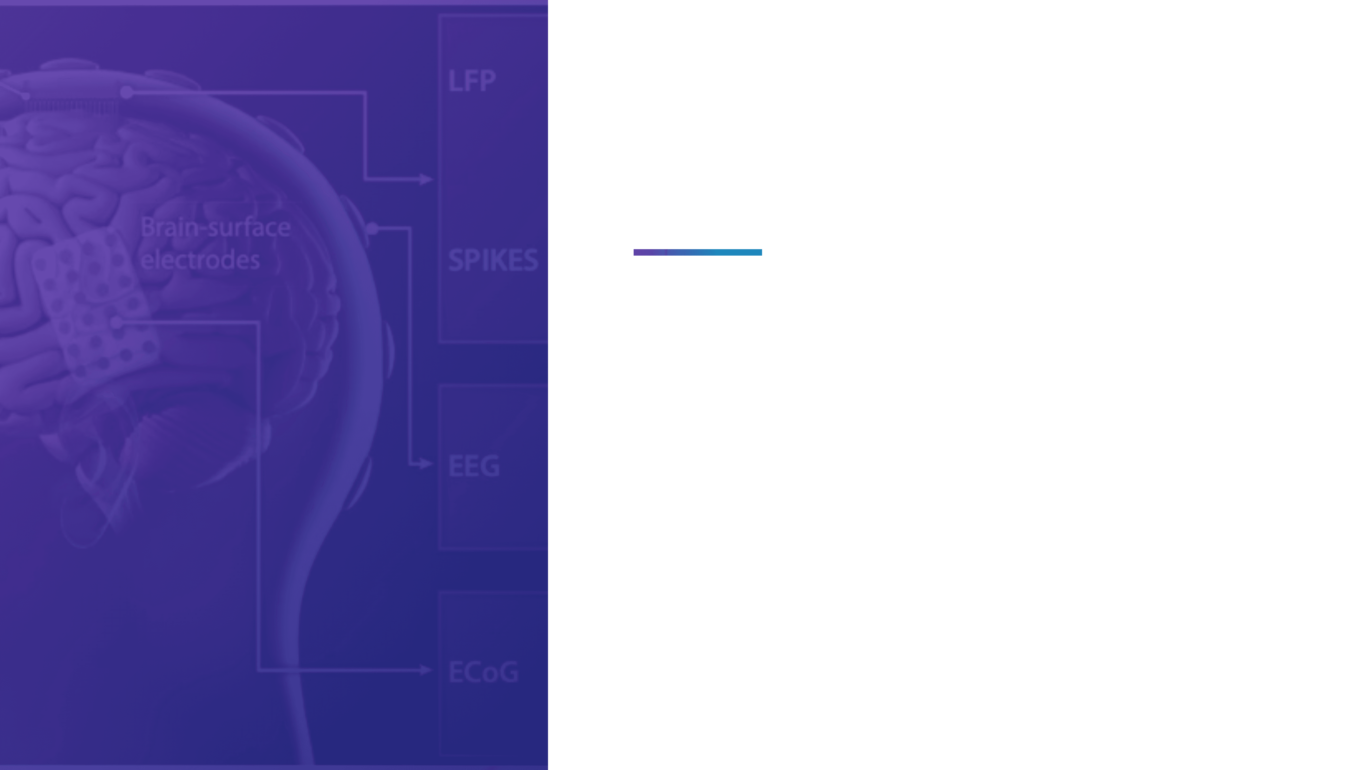
Brain2Action
Turning Brain Signals into Actions
BCI Motor Imagery Classification using Deep Learning
Capstone Project - UMBC DATA 606
Presented by: Dev Parikh

Slide 2

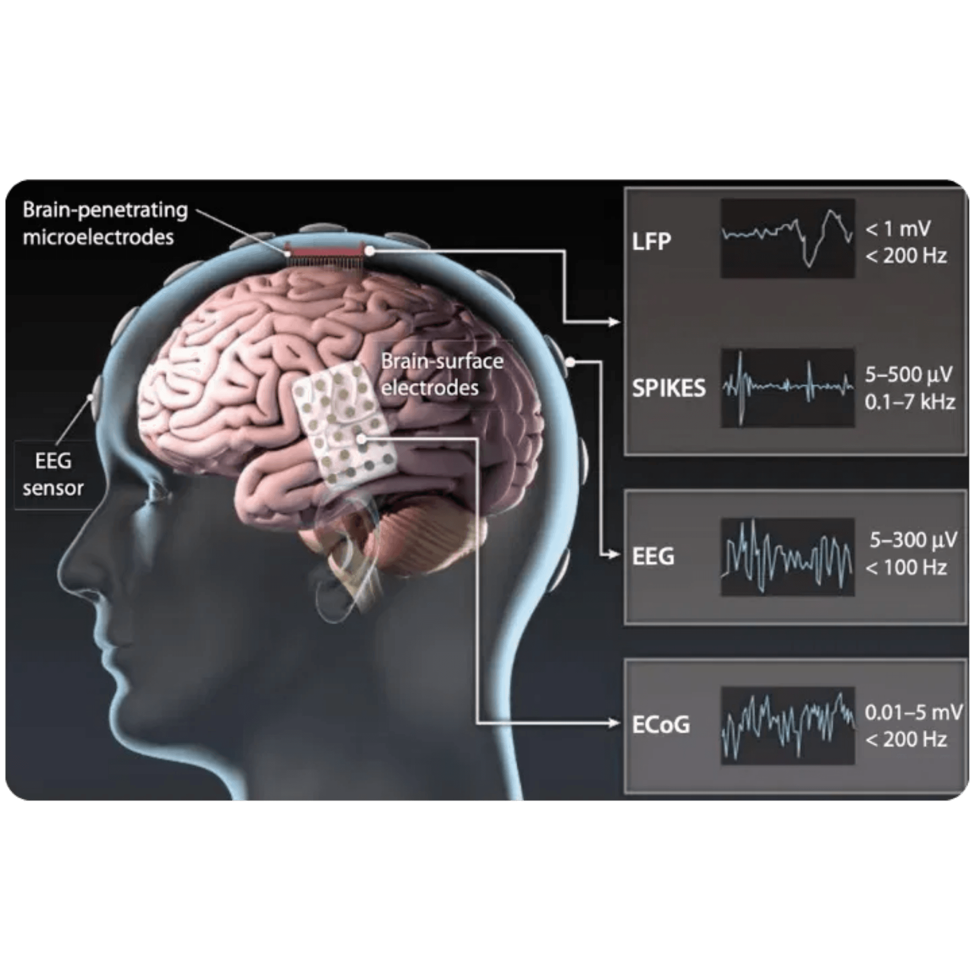
Brain-Computer Interfaces Enable Direct Communication Between Mind and Machine
Brain-Computer Interfaces create a direct communication pathway between the brain and external devices, bypassing traditional neuromuscular pathways. Motor imagery classification is particularly crucial for assistive technologies, as it enables people with motor disabilities to control devices through thought alone.
Key Applications:
Decode neural patterns from EEG signals to understand intended movements
Enable thought-controlled robotic systems for rehabilitation and assistance
Improve accessibility for individuals with paralysis or motor impairments
Provide alternative communication channels for locked-in syndrome patients
The challenge lies in accurately interpreting brain signals that represent imagined movements, transforming them into reliable control commands for external devices.

Slide 3

A Complete Deep Learning Pipeline from Raw EEG to Real-Time Predictions
System Components
EEGNet Architecture
Training Strategy Comparison
Compact convolutional neural network optimized for EEG signal classification with only 1,186 parameters
Subject-Dependent versus Subject-Independent approaches to understand generalization capabilities
Web Application
End-to-End Pipeline
Real-time prediction interface demonstrating practical deployment
Complete workflow from raw signal acquisition to user-facing predictions
Project Objectives
1
Classify left versus right hand motor imagery from EEG signals with high accuracy
Compare training strategies to identify optimal approaches for practical BCI applications
Demonstrate real-world applicability through an interactive web-based demonstration

Slide 4

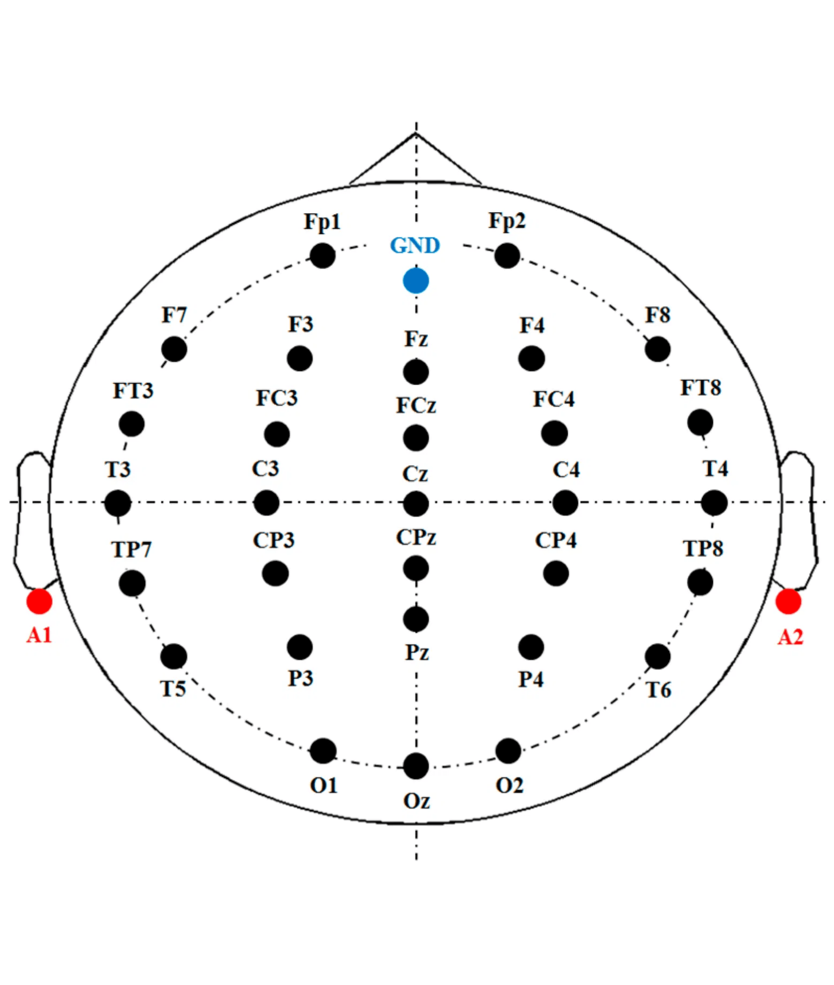
Motor Imagery Creates Detectable Neural Patterns Without Physical Movement
What is BCI?
•
Direct communication pathway between brain and external devices
•
Records brain activity using sensors
•
Translates neural signals into commands
Motor Imagery (MI)
Mental simulation of movement without physical execution. When a person imagines moving their left hand, specific regions of the motor cortex activate in patterns similar to actual movement, but without sending signals to muscles.
Left Hand MI: Imagining clenching or moving the left hand activates the right motor cortex
Right Hand MI: Imagining clenching or moving the right hand activates the left motor cortex
Goal: Distinguish which hand movement is being imagined based solely on brain signal patterns
This phenomenon, known as Event-Related Desynchronization, creates measurable differences in EEG signals that machine learning models can learn to classify.

Slide 5

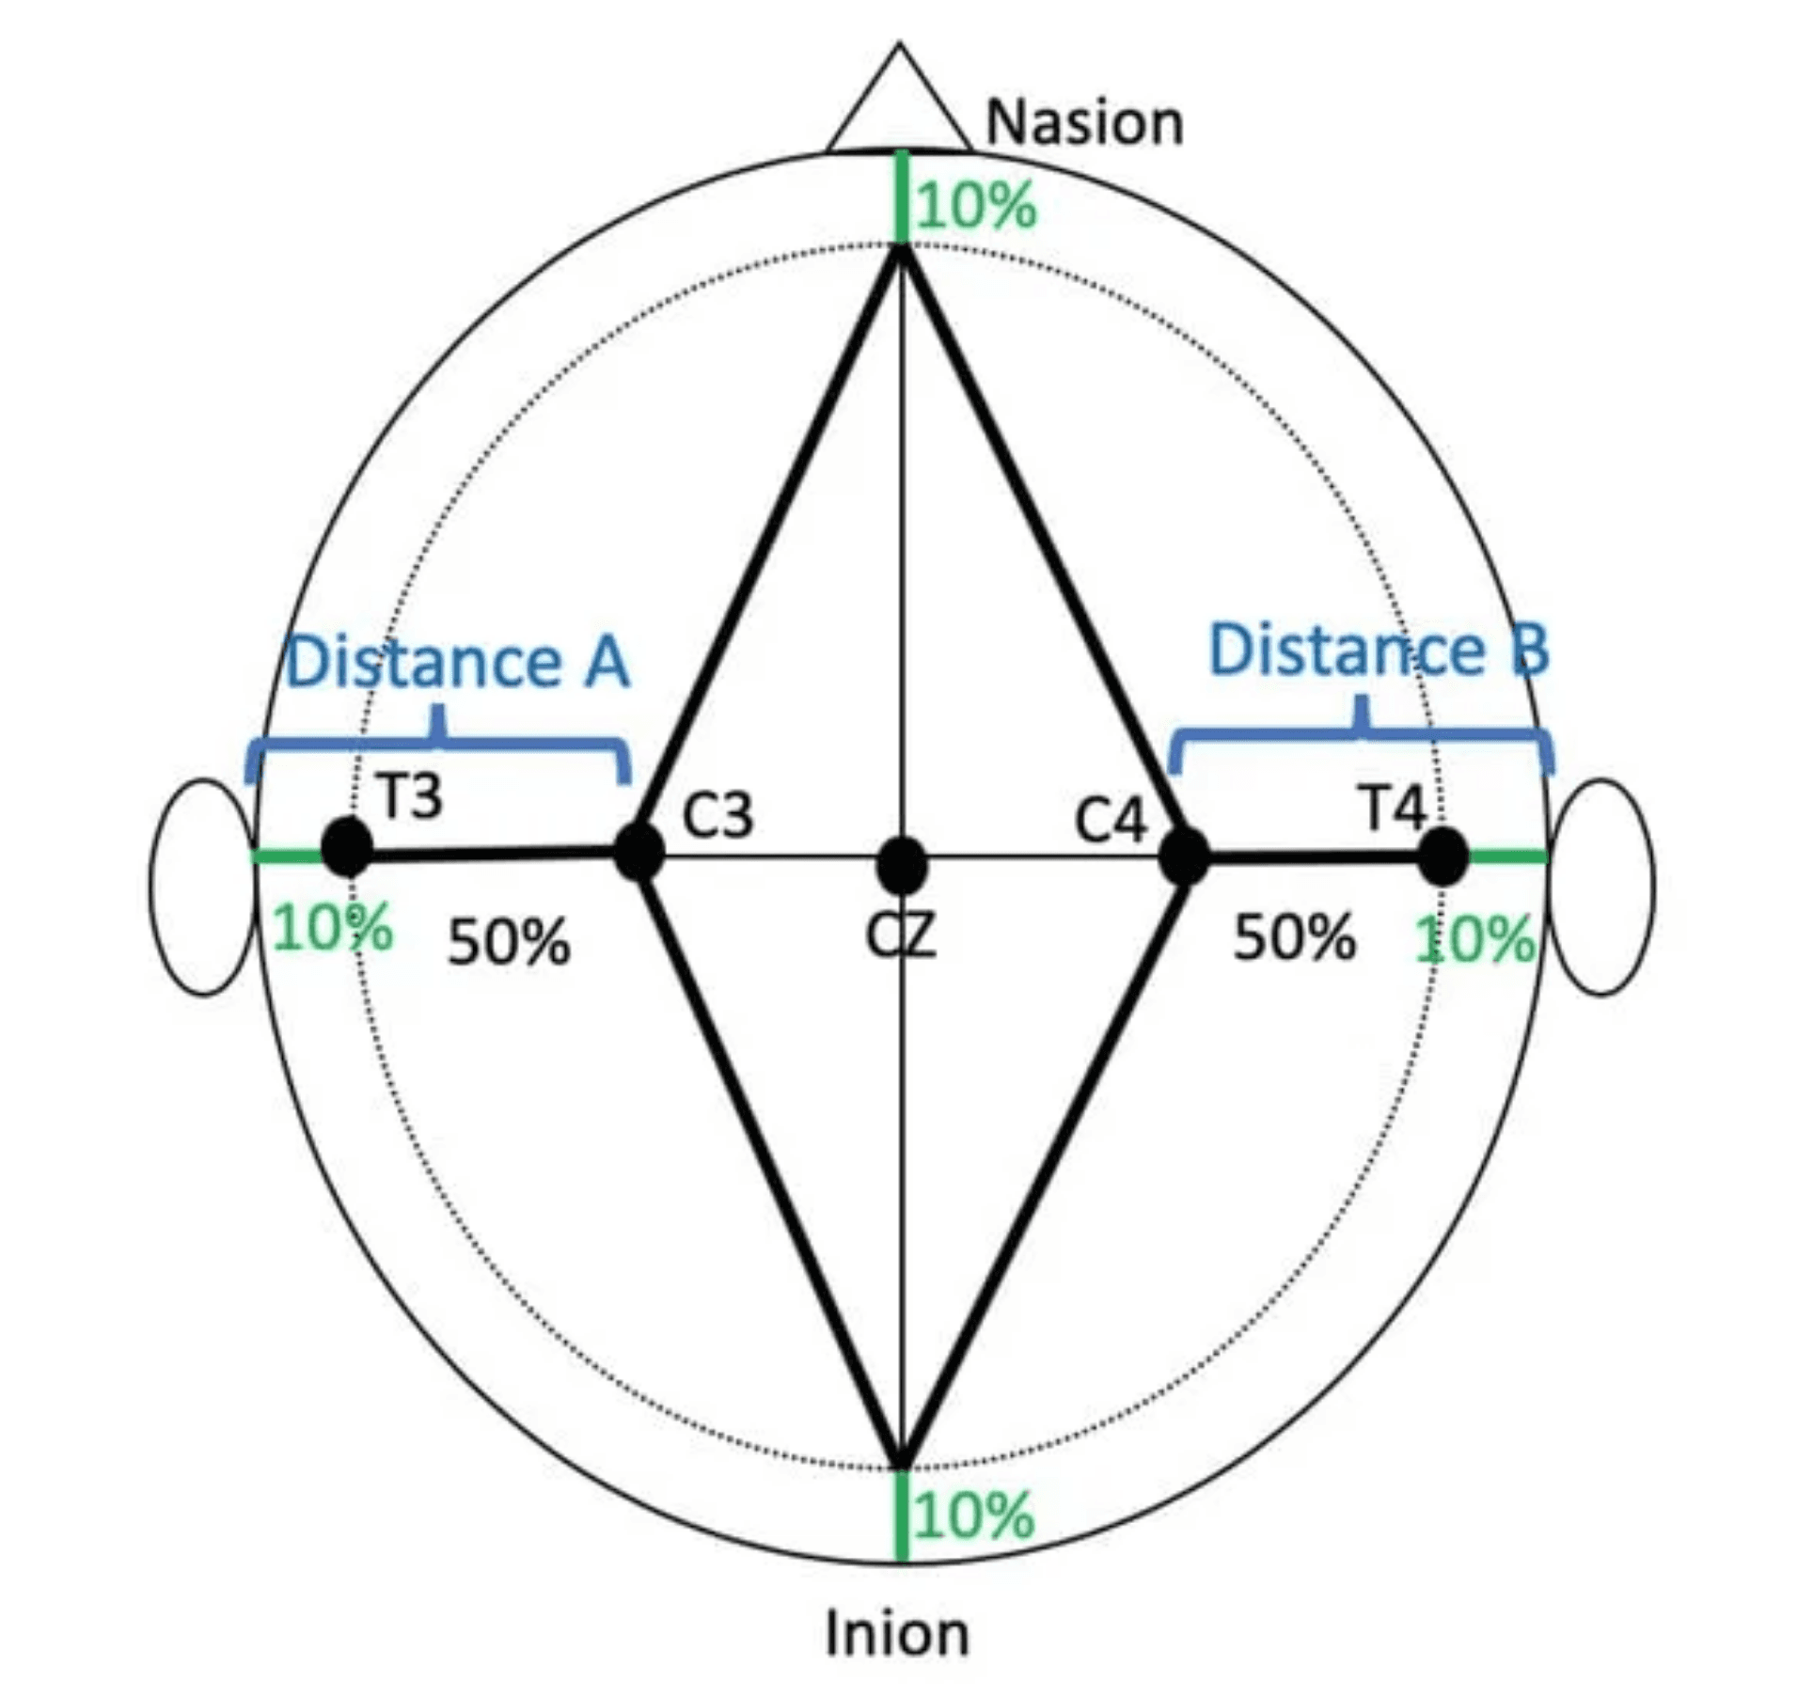
Strategic Electrode Placement Captures Motor Cortex Activity
Critical Electrode Positions
•
C3:
Positioned over the left motor cortex, primarily captures right-hand motor imagery
•
Cz:
Positioned over the central motor cortex, captures general motor activity
•
C4:
Positioned over the right motor cortex, primarily captures left-hand motor imagery
Signal Specifications
•
Sampling Rate:
250 Hz, providing sufficient temporal resolution for motor imagery frequencies
•
Frequency Range:
4-40 Hz, encompassing the mu band (8-12 Hz) and beta band (13-30 Hz) where motor imagery signals are strongest
•
Trial Duration:
4.5 seconds (from 2.5 to 7.0 seconds relative to the visual cue)
Scientific Rationale
These three channels capture Event-Related Desynchronization in the mu and beta frequency bands, which are the primary neural signatures of motor imagery. When a person imagines hand movement, power in these frequency bands decreases in the contralateral motor cortex, creating a detectable pattern.

Slide 6

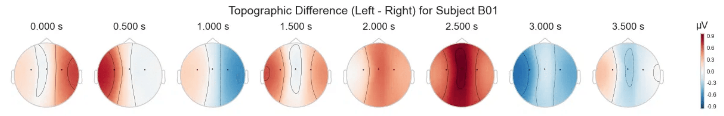

Neural Activity Patterns Distinguish Left- and Right-Hand Motor Imagery
Topographic Difference Maps (Left - Right) for Subject B01
Spatial distribution of brain activity differences between left- and right-hand motor imagery across time. Red indicates stronger activity during left hand imagery; blue indicates stronger activity during right hand imagery. The contralateral activation pattern (right hemisphere for left hand, left hemisphere for right hand) is clearly visible.
Average Event-Related Potential (ERP) for Subject B01
Temporal dynamics of brain activity during motor imagery trials. The blue line represents left hand trials, and the orange line represents right hand trials. The divergence between the two conditions around 0.5-1.5 seconds indicates the period when motor imagery-related neural activity is most distinguishable, providing the optimal time window for classification.

Slide 7

Systematic Investigation from Signal Analysis to Practical Application
Research Questions
Four-Phase Methodology
How effectively can deep learning architectures classify motor imagery from minimal EEG channels?
Phase 1: Exploratory Data Analysis
Signal quality assessment, class balance verification, frequency domain characteristics
How robust are trained models to inter-subject variability and signal noise?
Which training strategy—Subject-Dependent or Subject-Independent—produces better practical results?
Phase 2: Model Development
EEGNet implementation, three-channel adaptation, parameter optimization
How can trained models be integrated into real-world systems for end-user interaction?
Phase 3: Training and Evaluation
Subject-Dependent and Subject-Independent training with statistical comparison
Phase 4: Application Development
Web-based interface, real-time prediction, practical deployment demonstration

Slide 8

BCI Competition IV Dataset Provides Gold-Standard Benchmark Data
Dataset Overview
Data Structure
Recording Configuration
Source
Training Sessions
EEG Channels
Graz University of Technology
3 per subject (01T, 02T, 03T)
C3, Cz, C4 (motor cortex)
Subjects
Evaluation Sessions
EOG Channels
9 right-handed individuals (B01-B09)
2 per subject (04E, 05E)
3 electrooculogram channels
Format
Purpose
Sampling Rate
GDF (General Data Format) files
Training sessions for model development, evaluation for testing
250 Hz
Task
Trial Duration
Binary motor imagery: left vs right hand
Class Balance
4.5 seconds per trial
Approximately equal left- and right-hand trials
Total Trials
~300-400 trials per subject

Slide 9

Multi-Stage Preprocessing Pipeline Ensures Signal Quality
1
Bandpass Filtering (4-40 Hz)
2
Notch Filtering (50 Hz)
Isolates the frequency range containing motor imagery information while removing low-frequency drift and high-frequency noise.
Eliminates power line interference that contaminates EEG recordings in European settings.
3
Channel Selection
4
Epoch Extraction
Extracts only the three motor cortex channels (C3, Cz, C4), discarding EOG channels after artifact assessment.
Segments continuous EEG into 4.5-second trials (2.5 to 7.0 seconds relative to cue), yielding 1,125 samples per trial at 250 Hz.
5
Z-score Normalization
6
Trial Validation
Standardizes each channel independently to zero mean and unit variance, ensuring consistent scale across subjects and sessions.
Removes trials marked as rejected in the dataset annotations due to artifacts or technical issues.
Complete Pipeline
Raw EEG
→
Bandpass Filter
→
Notch Filter
→
Channel Selection
→
Epoch Extraction
→
Normalization
→
Train/Val Split
This preprocessing pipeline transforms raw, noisy EEG signals into clean, standardized input suitable for deep learning classification.

Slide 10

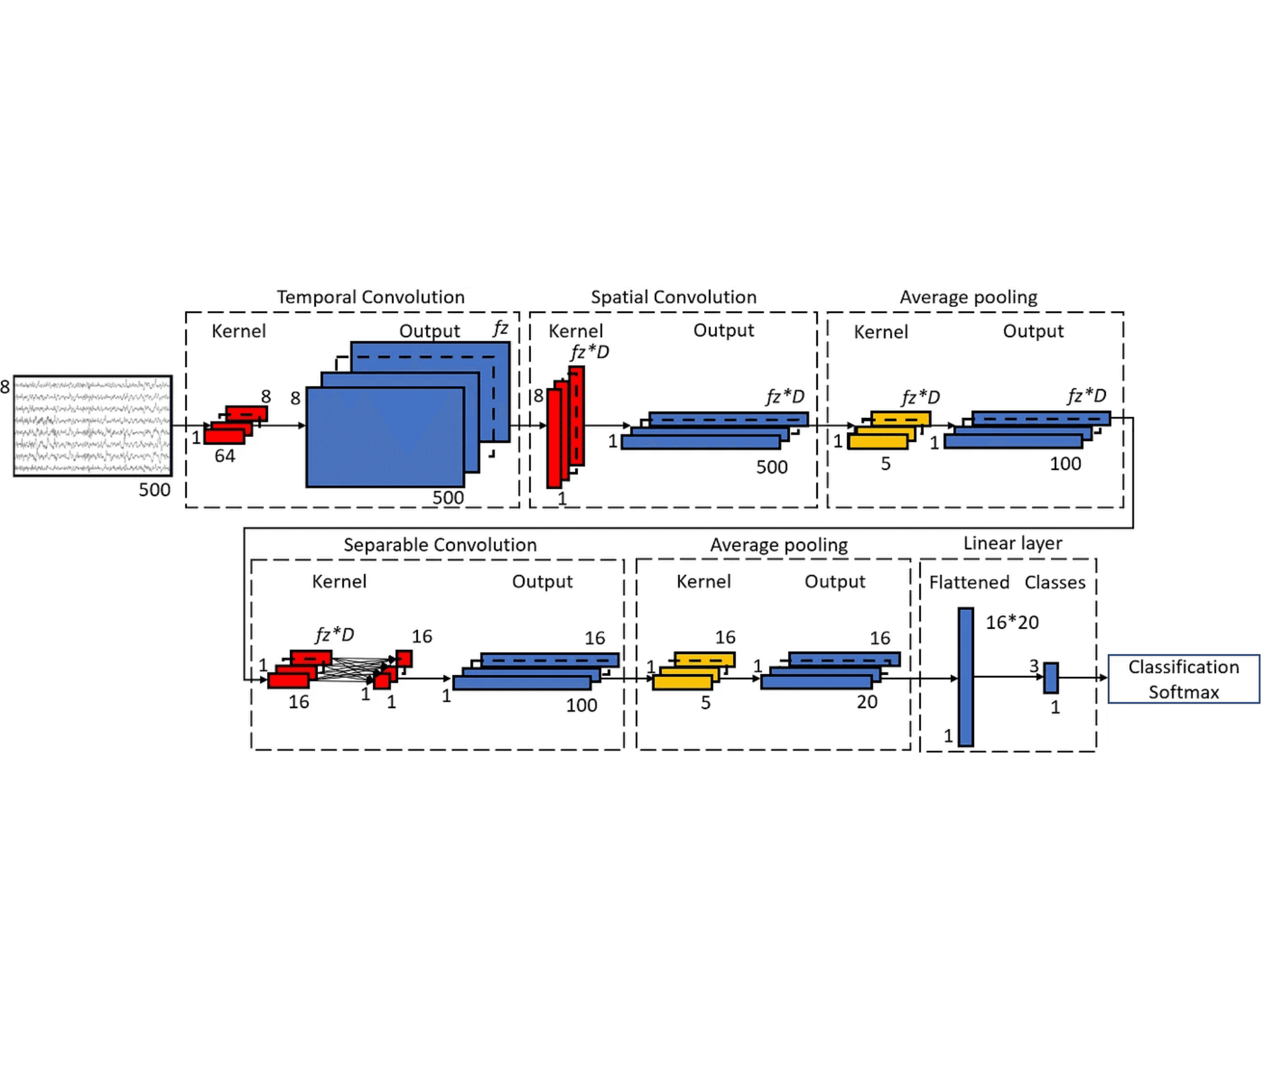
EEGNet Architecture Provides Compact and Efficient Classification
Why EEGNet?
EEGNet is a compact convolutional neural network specifically designed for EEG signal classification. With only 1,186 trainable parameters, it achieves strong performance while remaining computationally efficient and resistant to overfitting on limited data.
Architecture Design
Block 1: Temporal convolution captures frequency-domain patterns across time, followed by depthwise convolution for spatial filtering and average pooling for dimensionality reduction
▸
Block 2: Separable convolution combines features across channels efficiently with additional pooling and dropout regularization to prevent overfitting
▸
Classification Head: Global average pooling aggregates features across time, with a single dense layer and softmax activation producing class probabilities
▸
Key Hyperparameters
•
F1 = 8:
Number of temporal filters in the first layer
•
F2 = 16:
Number of pointwise filters in separable convolution
•
D = 2:
Depth multiplier for spatial filtering
•
Total Parameters:
1,186 (extremely compact for deep learning)

Slide 11

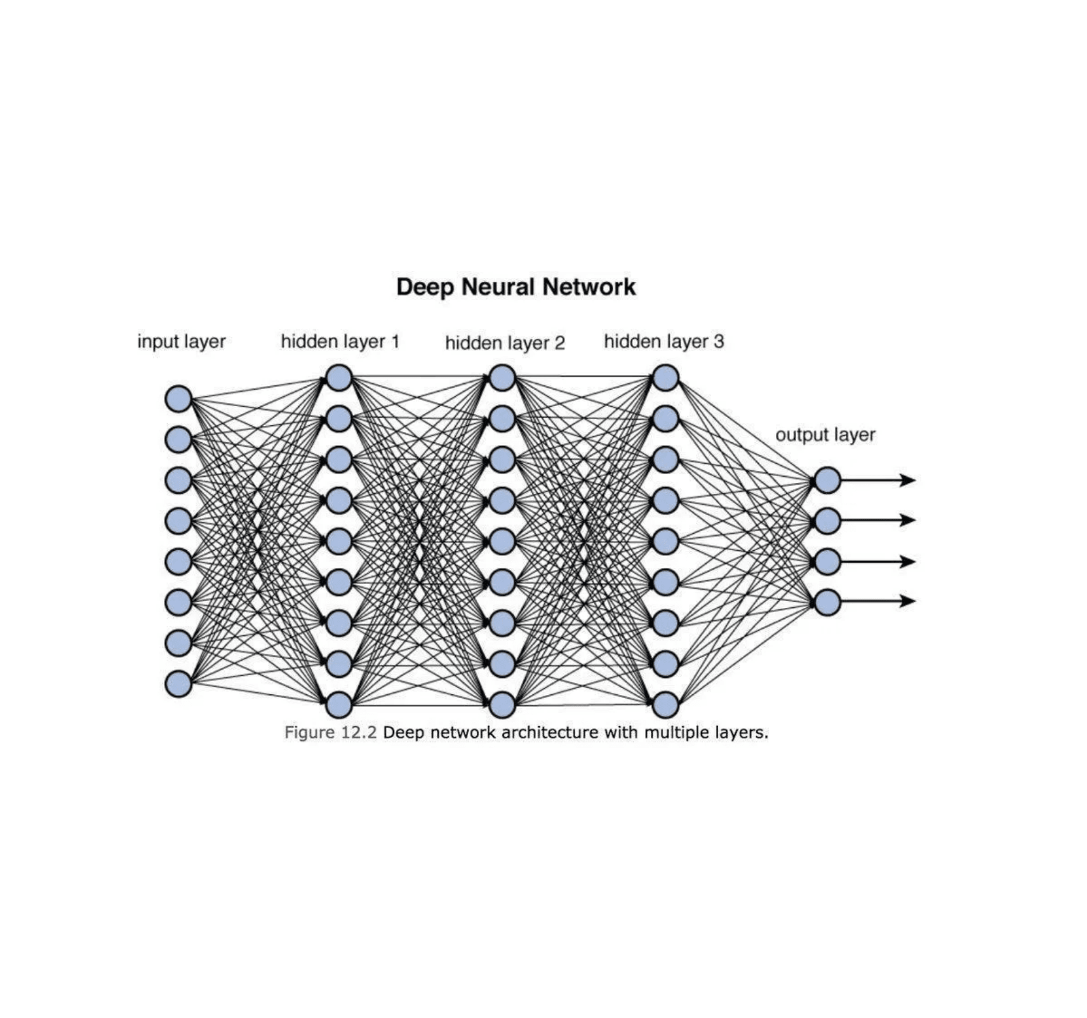
Two Training Strategies Test Personalization Versus Generalization
Training Configuration
Optimizer: Adam (LR: 0.001)
Batch Size: 64
Loss Function: Cross-entropy
Maximum Epochs: 500
Early Stopping: Patience = 50
Training Strategies
Subject-Dependent Training
Each subject receives a personalized model trained exclusively on their own data. This approach uses 3-fold cross-validation within each subject's training sessions, resulting in nine separate models (one per subject). This strategy captures individual neural patterns and brain signal characteristics.
Subject-Independent Training
Models are trained to generalize across different individuals using Leave-One-Subject-Out cross-validation. For each test subject, a model is trained on three randomly selected subjects and evaluated on the held-out subject. This approach tests whether a single model can work for new users without personalized calibration.
Subject-Dependent training represents the practical BCI scenario where users calibrate the system before use. Subject-Independent training represents the ideal scenario where a pre-trained model works immediately for new users without calibration.

Slide 12

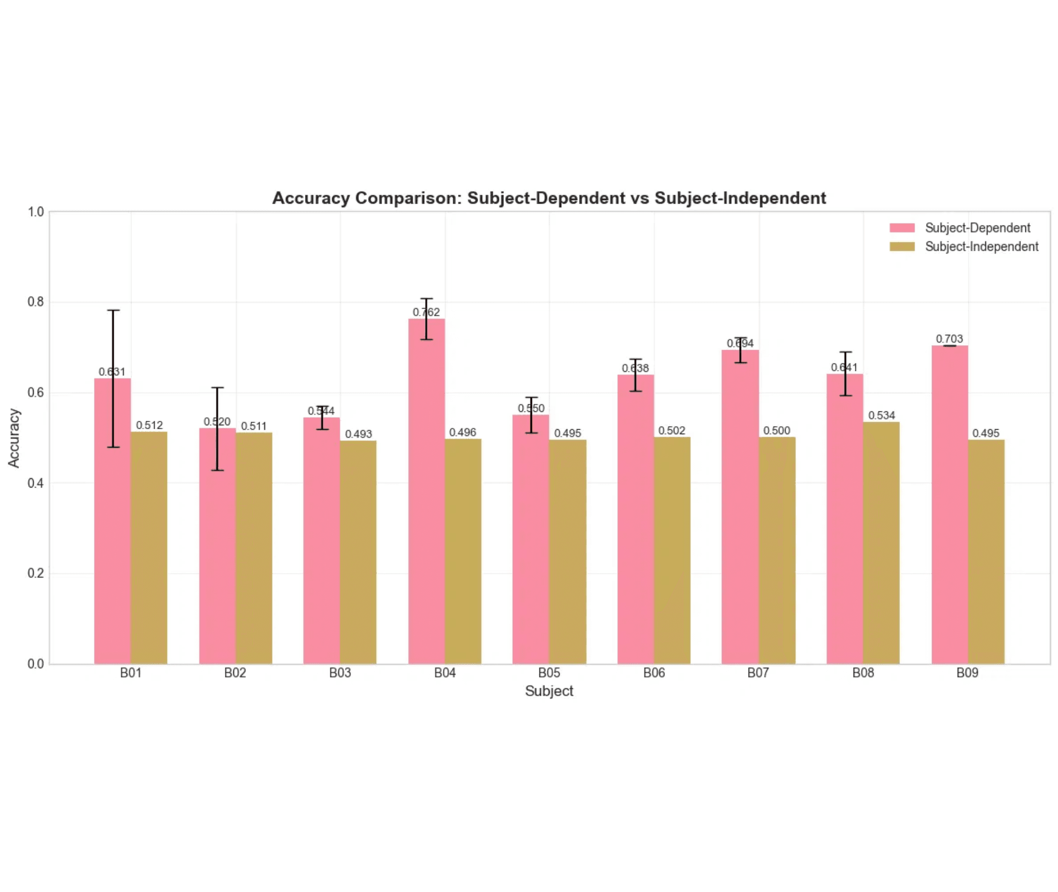
Subject-Dependent Training Achieves 25% Higher Accuracy Than Generalized Models
Subject-Dependent Performance
63.17% ± 9.59%
Best: B04 (76.25%) | Weakest: B02 (52.02%)
Significant inter-subject variability indicates individual neural patterns
Subject-Independent Performance
50.42% ± 1.30%
Near chance level (50% for binary classification)
Consistently poor generalization across all subjects
Statistical Validation
Paired t-test: p = 0.0018 < 0.05 ✓ Performance Gap: 25.3% relative improvement Subject-Dependent training produces statistically significant improvement

Slide 13

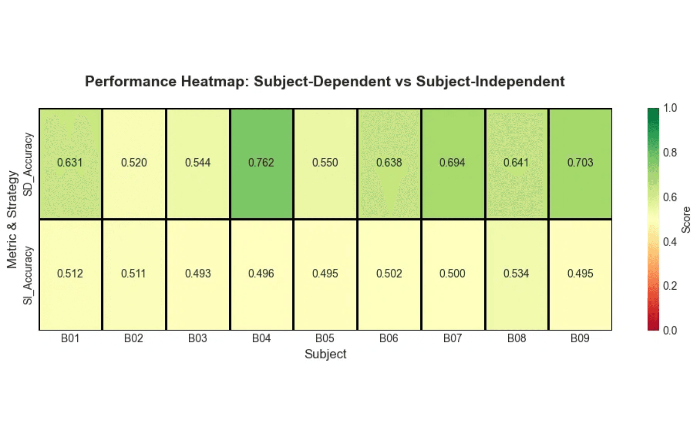
Performance Heatmap Reveals Consistent Subject-Dependent Advantage
Visual Performance Comparison
The heatmap visualizes accuracy scores using color intensity, where darker green indicates higher performance. The top row shows Subject-Dependent (SD) accuracy, and the bottom row shows Subject-Independent (SI) accuracy for each of the 9 subjects.
Key Insights
▸
Subject-Dependent row shows consistently higher intensity (darker green) across all subjects
▸
Subject B04 achieves the highest performance (0.762) with Subject-Dependent training
▸
Subject-Independent row shows uniformly low performance (yellow tones) near chance level
▸
No subject benefits from Subject-Independent training, confirming the need for personalization
This visualization reinforces the quantitative finding that personalized calibration is essential for practical BCI systems, as generalized models fail to capture individual neural patterns.

Slide 14

Personalized Models Are Essential for Practical BCI Applications
Why Subject-Dependent Training Wins
✓
Superior Performance
63% versus 50% represents the difference between a usable system and random guessing. For BCI applications, this accuracy gap determines whether users can reliably control devices.
✓
Captures Individual Neural Signatures
Each person's brain generates unique signal patterns based on anatomy, neural organization, and cognitive strategies. Subject-Dependent models learn these individual characteristics.
✓
Aligns with Real-World BCI Practice
Commercial and research BCI systems universally require user-specific calibration sessions. Our results validate this established practice with quantitative evidence.
✓
Improves User Experience
Higher accuracy translates directly to better control, reduced frustration, and increased user confidence in the system.
Subject-Independent Limitations
✗
50% accuracy is equivalent to random guessing for binary classification
✗
Cannot capture subject-specific neural patterns and signal characteristics
✗
High inter-subject variability in brain anatomy and signal quality prevents effective generalization
Recommendation: For practical BCI applications, Subject-Dependent training with personalized calibration is necessary to achieve reliable performance. Future work should focus on reducing calibration time rather than eliminating it entirely.

Slide 15

Complete System Achieves Research Goals and Technical Milestones
Classification Performance
Technical Achievements
✓
Successfully distinguished left versus right hand motor imagery with 63.17% mean accuracy
✓
Implemented complete preprocessing pipeline handling raw EEG signals
✓
Deployed EEGNet architecture with optimized hyperparameters
✓
Trained nine subject-specific models, each optimized for individual neural patterns
✓
Established robust training framework with cross-validation and early stopping
✓
Achieved statistically significant improvement over baseline approaches
✓
Developed web application demonstrating real-time prediction capabilities
✓
Demonstrated practical viability for assistive BCI applications
Key Performance Metrics
System Validation
Subjects Evaluated
The complete pipeline from raw signal acquisition through preprocessing, model training, and real-time prediction has been validated on benchmark data and deployed in an interactive demonstration application. Subject-Dependent training achieved 25.3% relative improvement over Subject-Independent approaches, confirming the necessity of personalized calibration for practical BCI systems.
9 Subjects
Subject-Dependent Accuracy
63.17%
Model Parameters
1,186 Parameters

Slide 16

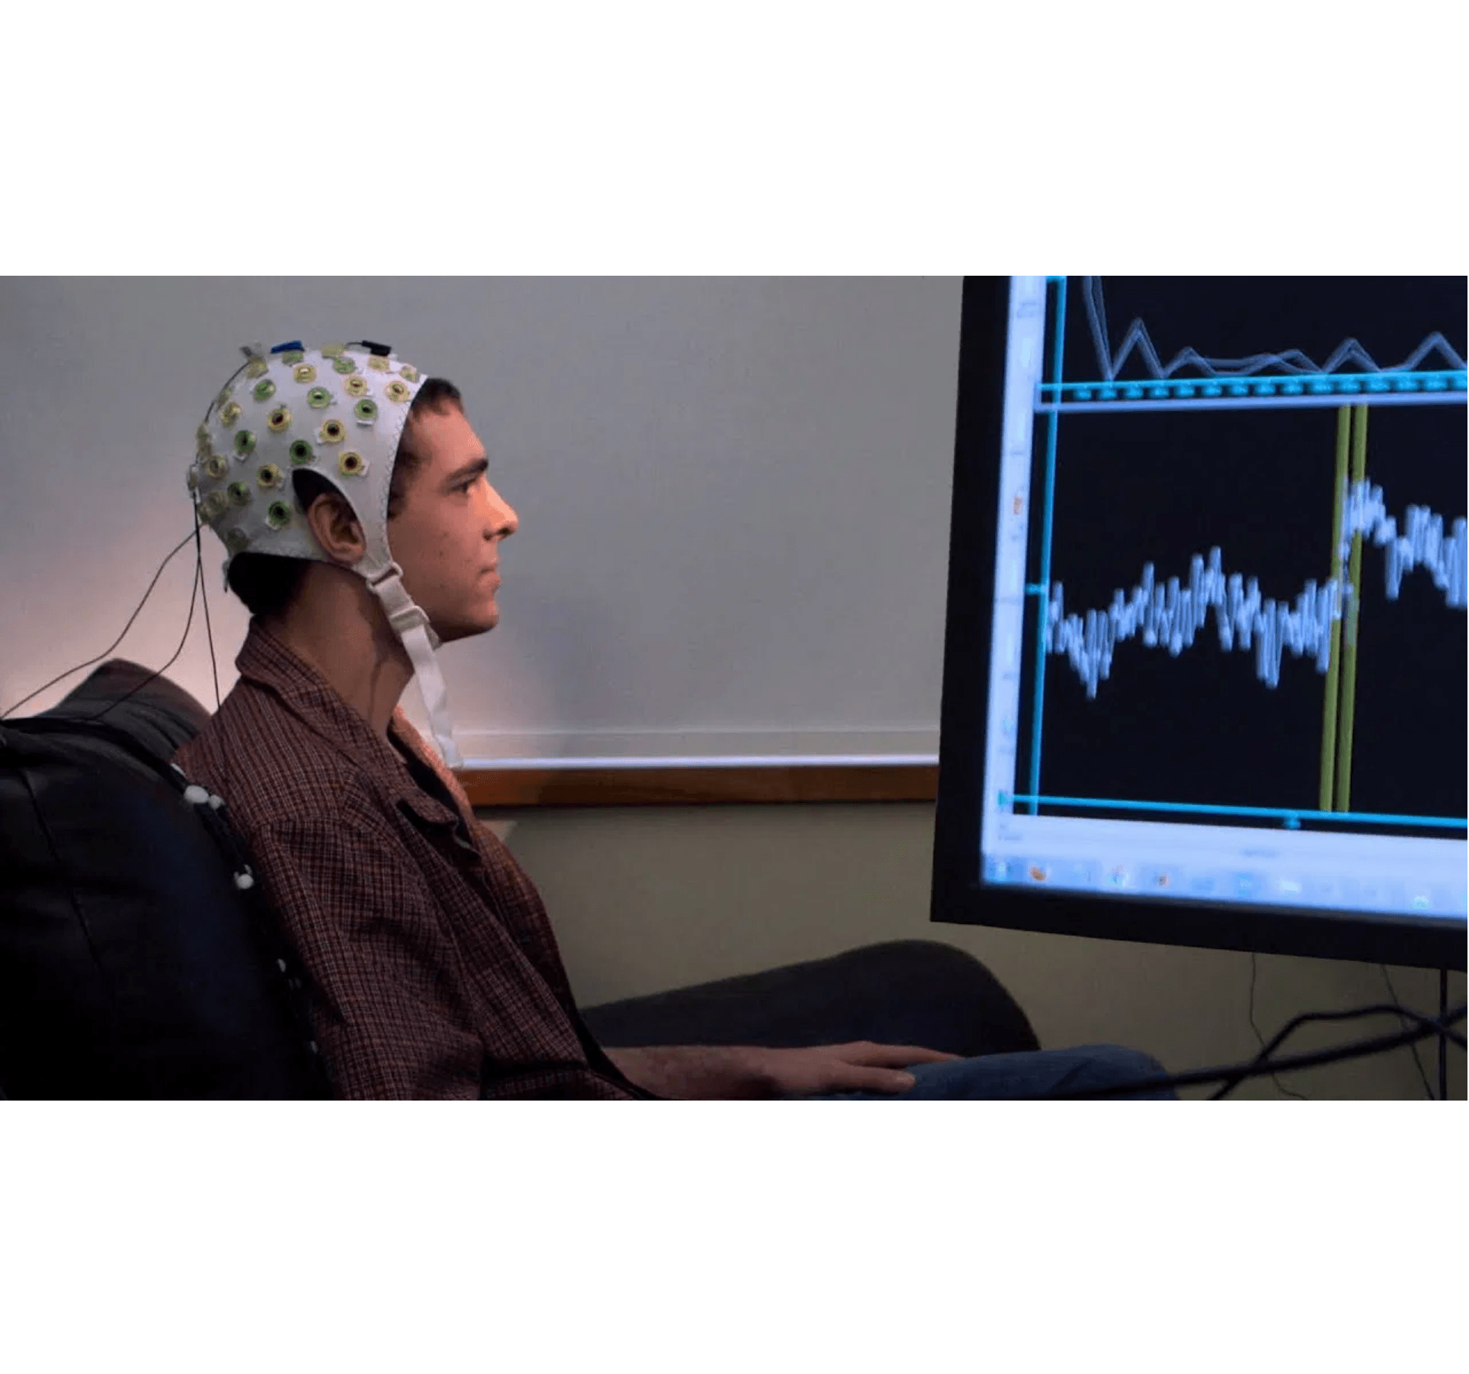
Interactive Web Application Demonstrates Real-World Deployment
Application Features
▸
Subject Selection: Choose from nine trained subjects (B01 through B09)
▸
Real-Time Prediction: Upload EEG trial data and receive immediate classification
▸
Result Visualization: Display predicted class (left or right hand) with confidence scores
▸
Interactive Interface: User-friendly design for demonstration and testing
Technical Implementation
Frontend Stack
React framework with TypeScript for type-safe component development and responsive design for desktop and mobile access
Backend Stack
Django REST API for model serving and request handling with efficient preprocessing pipeline integrated into API endpoints
Model Serving
PyTorch for model inference with trained EEGNet weights
The application demonstrates that trained models can be successfully deployed in web environments, making BCI technology accessible through standard browsers without specialized software installation.

Slide 17

Project Delivers Comprehensive BCI Classification System
Key Findings
Project Contributions
✓
Subject-Dependent Superiority
Methodological Contribution
63.17% accuracy versus 50.42% for Subject-Independent, representing a 25.3% relative improvement and validating the need for personalized calibration
Comprehensive comparison of Subject-Dependent versus Subject-Independent training strategies with statistical validation, providing evidence-based guidance for BCI system design
✓
Efficient Architecture
EEGNet's compact design with only 1,186 parameters proves that effective BCI classification doesn't require massive models
Technical Contribution
Reproducible deep learning pipeline for EEG motor imagery classification, including preprocessing code, model architecture, and training procedures that other researchers can adapt
✓
Complete Pipeline
End-to-end system from raw signal preprocessing through model training to web application deployment
Application Contribution
✓
Practical Readiness
Interactive web application demonstrating practical deployment of BCI models, bridging the gap between research and real-world use
Demonstrated real-world applicability through interactive web interface
Benchmark Contribution
Performance metrics on BCI Competition IV Dataset 2b, enabling comparison with other approaches and tracking progress in the field

Slide 18

Future Work Can Enhance Data Quality, Model Sophistication, and Applications
Data Collection Improvements
Model Architecture Enhancements
Application Expansions
▸
Larger Datasets:
▸
▸
Increase trials per subject from 300-400 to 1,000+ for better model training
Attention Mechanisms:
Add attention layers to focus on most informative time segments and channels
Real-Time Streaming:
Process continuous EEG streams rather than segmented trials
▸
More Subjects:
▸
Expand from 9 to 20+ subjects for better generalization research
Robotic Integration:
Connect to robotic arms, wheelchairs, or prosthetic devices for direct control
▸
Transformer Models:
Explore transformer architectures that have shown promise in time-series classification
▸
Better Hardware:
High-density EEG caps with 64+ channels for finer spatial resolution
▸
Smart Home Control:
Enable thought-based control of lights, temperature, and appliances
▸
Transfer Learning:
▸
Dry Electrodes:
Pre-train on large multi-subject datasets, then fine-tune for individual users to reduce calibration time
Eliminate gel-based electrodes for faster setup and improved user experience
▸
Multi-Class Classification:
Extend beyond binary to classify multiple imagined movements
▸
Ensemble Methods:
Combine multiple models for improved robustness
Long-Term Vision
Making Brain-Computer Interfaces affordable, easy to use, and widely available for people with motor disabilities, transforming assistive technology accessibility.

Slide 19

Thank You
Questions & Discussion
Contact Information
Dev Parikh
(dparikh3@umbc.edu)
Project Resources
GitHub Repository:devparikh0506/UMBC-DATA606-Capstone
Dataset: BCI Competition IV Dataset 2b
Live Demo: https://drive.google.com/file/d/1nmGfXHfEOkcjum4EAGbh1-seg8GWmvAQ/view?usp=sharing

